Slide 1
Intelligent Agents
Session 02
Henry Lucky, S.Kom., M.Kom.

Slide 2
Learning Outcomes
Session 2
At the end of this session, students will be able to:
LO 1: Describe the concept of the intelligent agent and Artificial Intelligence

Slide 3
outline
Session 2
Agent
Agent Type
Evaluating Agents
Environment Types
Exercise

Slide 4
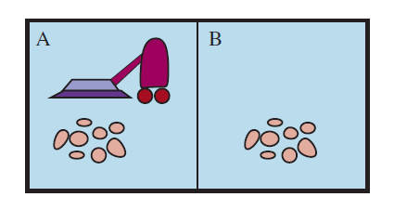
Introduction
Vacuum world
The environment : Location A and Location B; Either can be clean or dirty
The Agent : Vacuum Cleaner
The Task : Clean both A and B

Slide 5
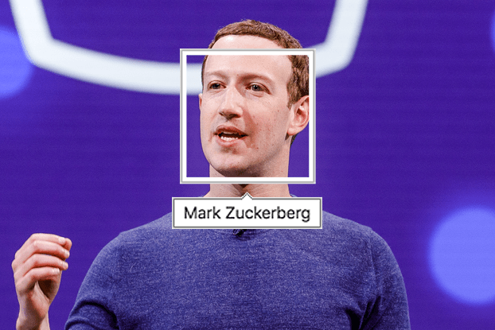
Introduction
Vacuum world
The environment : A photograph
The Agent : Program
The Task : Find Face, Identify them

Slide 6
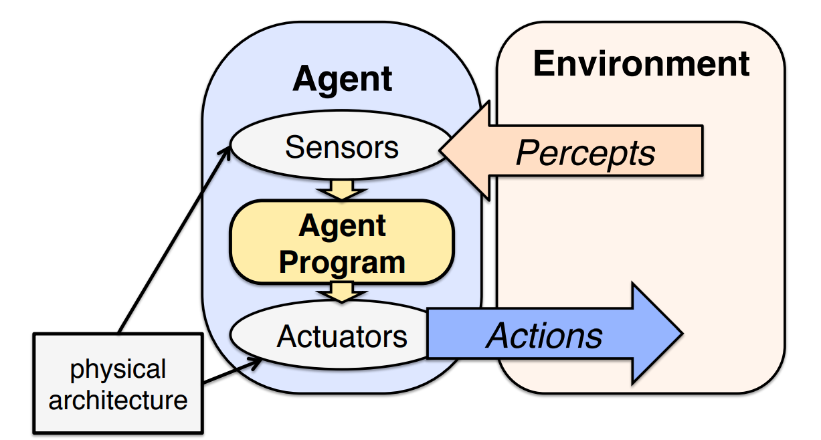
Agent
Definition
An agent is a system that perceives its environment through sensors and acts upon the environment through actuators

Slide 7
Agent
Definition
Sensor: eyes, ears, nose (human); camera, microphone (robot)
Percept: the perceptual input at any instant
Percept Sequence: the complete history of what the agent has perceived
Actuator: arms, legs (human, robot), hose (vacuum)

Slide 8
Agent
Example: vacuum cleaner
Sensor : Camera
Percept : Current Location is clean or dirty
Actions : Move left, move right, suck

Slide 9
Agent
The agent program “The brain”
The agent program decides what action to take in each situation
  Situation = the current percept sequence
  It implements a mapping from percept sequences to actions (the agent function)
Percept Sequence | Action
[A, Clean] | Move Right
[A, Dirty] | Suck
[A, Clean] , [A, Dirty] | Suck

Slide 10
Agent
Agent function vs agent program
Agent Function:
  A (complete) mapping from sequences of percepts to actions
Agent Program:
  What is actually implemented in the agent.

Slide 11
Agent type
5 basic agent types
Five basic type of agents:
  Simple reflex agents
  Model-based reflex agents
  Goal-based agents
  Utility-based agents
  Learning-based agents

Slide 12
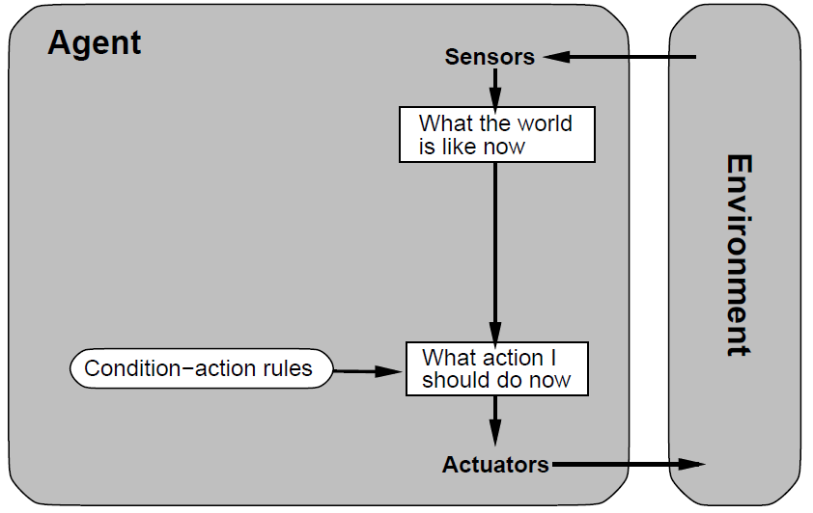
Agent type
Simple reflex agent
Action depends only on current state only.
Agent has no memory
Ignore the sensors history.

Slide 13
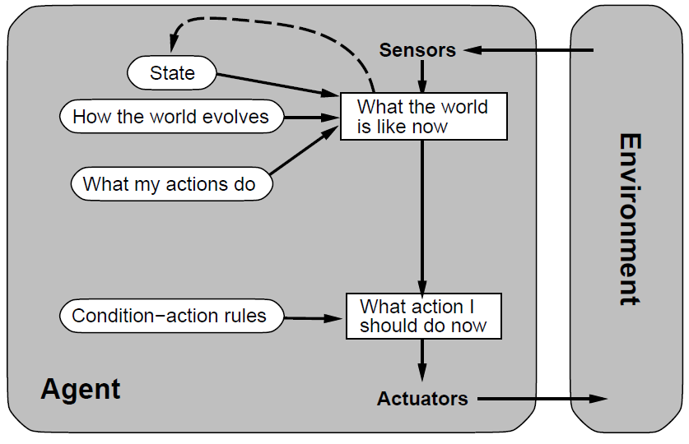
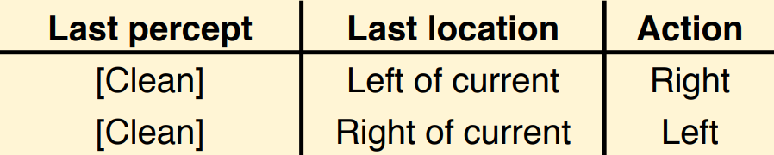
Agent type
Model-based reflex agent
Agent has an internal model of the current state of the world
  Example: the agentʼs previous location; current locations of all objects it has seen;

Slide 14
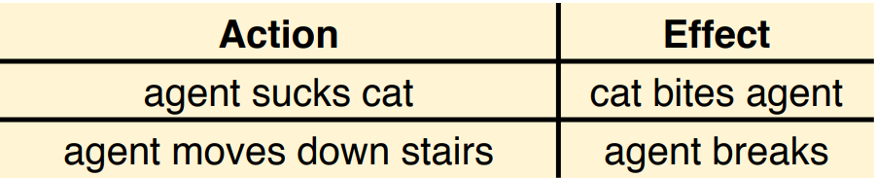
Agent type
Model-based reflex agent
Agent may also have (generic) domain knowledge of the world
  Example: Effects of agentʼs actions, behavior of entities in the environment

Slide 15
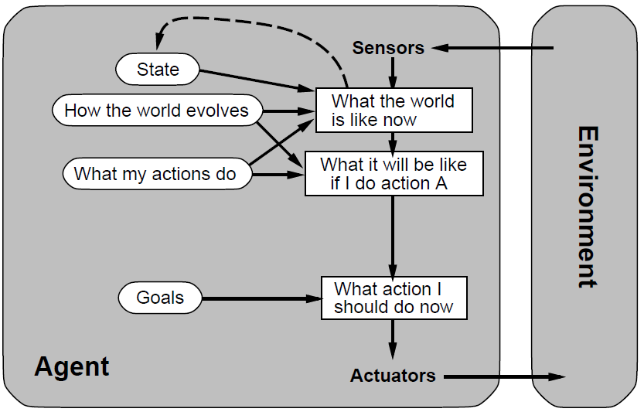
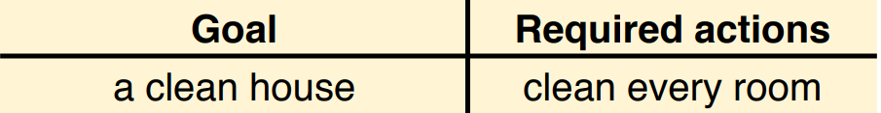
Agent type
Goal-based agent
Agent has a goal, which may require a sequence of actions. (This requires searching or planning)

Slide 16
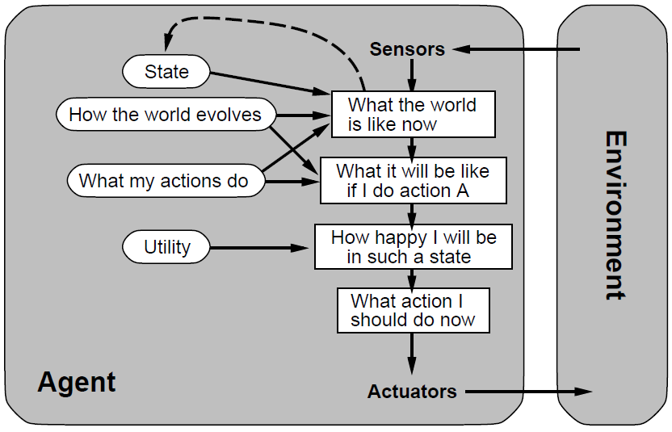
Agent type
Utility-based agent
Agent can choose between multiple actions to achieve its goal. Which is best?
Agent may have conflicting goals. Which one to pursue first?
Agents may have a utility function, which (ideally) approximates the external performance measure

Slide 17
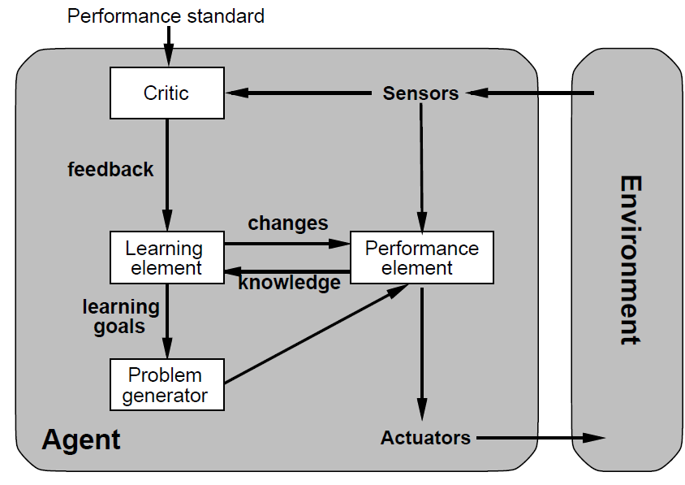
Agent type
Learning-based agent
We cannot foresee every eventuality. Agents need to change their behavior to adapt to their environment.
This requires an (external) teacher or reward which tell the agent how well it is currently doing.

Slide 18
Evaluating agent
How well does the agent perform
Objective evaluation:
  What are the consequences of its actions on the environment?
Performance measure:
  Do the agentʼs actions reach the desired state of the environment ?
    We donʼt care about the state of the agent
    We usually donʼt care how the agent behaves to reach its goal

Slide 19
Evaluating agent
Rationality
The rationality of an agent depends on
  the performance measure defining the agent’s degree of success
  the percept sequence, the sequence of all the things perceived by the agent
  the agent’s knowledge of the environment
  the actions that the agent can perform
A rational agent should always choose the action that maximizes its expected performance, given the current situation

Slide 20
Evaluating agent
Rationality
Rational ≠ omniscient
Rational ≠ clairvoyant
Rational ≠ successful
Rational ⇒ exploration, learning, autonomy

Slide 21
Evaluating agent
Strategies for maximizing Expected performance
Information gathering (first look, then act):
  Choose an action that yields a more informative percepts for the following action
Learning (act according to prior experience)
  Augment or modify knowledge of the task or the environment according to experience.

Slide 22
Evaluating agent
Comparing agents and Tasks
The task environment specifies the problem that the agent has to solve.
It is defined by:
  the objective Performance measure (P)
  the external Environment (E)
  the agentʼs Actuators (A)
  the agentʼs Sensors (S)

Slide 23
Evaluating agent
PEAS Example
The task of designing an automated taxi:
  Performance measure:
    Safety, destination, profits, legality, comfort
  Environment:
    Streets/freeways, traffic, pedestrians, weather
  Actuators:
    Steering, accelerator, brake, horn, speaker/display
  Sensors:
    Cameras, accelerometers, gauges, engine sensors, keyboard, GPS

Slide 24
Environment types
Comparing Task Environments
Sensors:
  Fully observable: The percepts contain all relevant properties of the environment
  Partially observable: The percepts contain only some relevant properties of the environment
Knowledge:
  Known: Agent knows all the rules that hold in the environment. Can predict outcomes from complete observations
  Unknown: Agent doesnʼt know the rules of the environment. Canʼt predict outcomes.

Slide 25
Environment types
Comparing Task Environments
Actions:
  Deterministic: Outcome of actions (next state of the environment) is fully determined by the current state.
  Non-Deterministic : Each action has a set of possible outcomes.
  Stochastic: There is a probability distribution over possible outcomes.
Percept:
  Episodic: Agent receives a single percept per episode. Its action in this episode does not affect future percepts (e.g. classification)
  Sequential: Agent receives a sequence of percepts. The current action affects future percepts. (e.g. navigation, game playing)

Slide 26
Environment types
Comparing Task Environments
Environment:
  Static: Environment doesnʼt change unless agent performs an action. (e.g. crossword puzzles)
  Dynamic : Environment changes even when the agent doesnʼt do anything. (e.g. traffic).
  Semi-Dynamic: Environment is static, but agentʼs performance score changes over time. (e.g. chess against a clock).
Discrete or Continuous :
  Discrete: Time, percepts and actions are discrete. Example: playing a board game.
  Continuous: Time, percepts and actions are continuous. Example: driving a car.

Slide 27
Environment types
Comparing Task Environments
Agents:
  Single-agent environment: Performance of agent A does not depend on any other agents.
  Competitive multi-agent environment: Maximizing performance of agent A minimizes performance of agent B. (competitive games)
  Cooperative multi-agent environment: Maximizing performance of agent A maximizes performance of agent B. (avoiding traffic accidents)

Slide 28
Case study
Developing PEAS
Imagine a company wants to build an intelligent system to automate the process of sorting packages based on their weights and destinations in their warehouse. The aim is to enhance efficiency, speed, and accuracy in the sorting process, ensuring that packages are sorted and dispatched correctly to save both time and resources.
Your task is to develop the PEAS (Performance measure, Environment, Actuators, and Sensors) for this intelligent package sorting system.

Slide 29
References
Session 2
Hockenmaier, J. (n.d.). Lecture 2: Intelligent Agents. CS440/ECE448: Intro to Artificial Intelligence. Retrieved October 18, 2023, from https://courses.engr.illinois.edu/cs440/sp2011/slides/lecture02.pdf
Russell, S. J., Norvig, P., Chang, M., Devlin, J., Dragan, A., Forsyth, D., Goodfellow, I., Malik, J., Mansinghka, V., Pearl, J., & Wooldridge, M. J. (2022). Artificial intelligence: A modern approach (Fourth edition, global edition). Pearson.
Tinelli, C. (2017). Intelligent Agents. CS:4420 Artificial Intelligence. https://homepage.cs.uiowa.edu/~tinelli/classes/4420/Spring17/notes/2-agents.pdf

